Slide 1
Hovercraft
By: Jason Domogala and Siddhanta Panda

Slide 2
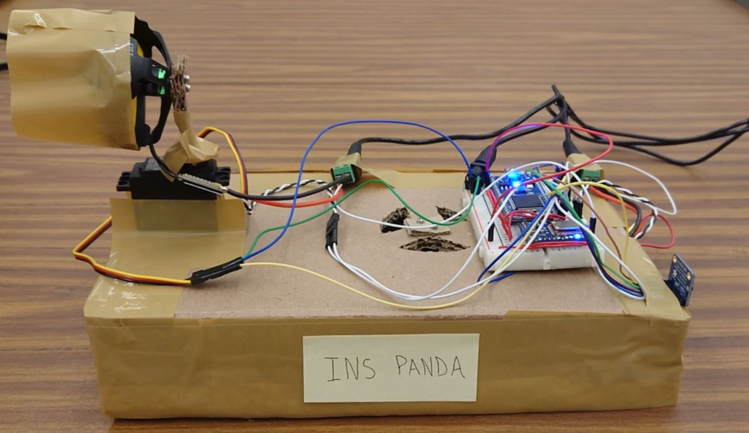
Project Idea
Fully functional hovercraft using brushless DC motors
Bluetooth controlled via Adafruit App
MBED microcontroller
LIDAR for collision avoidance

Slide 3
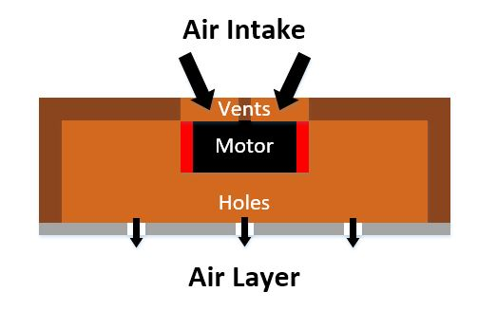
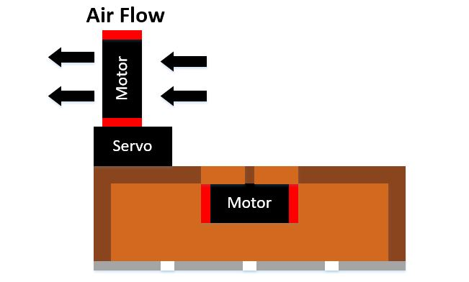
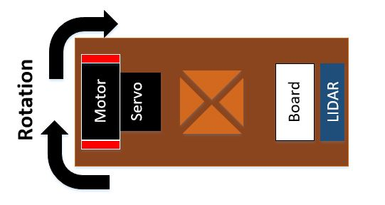
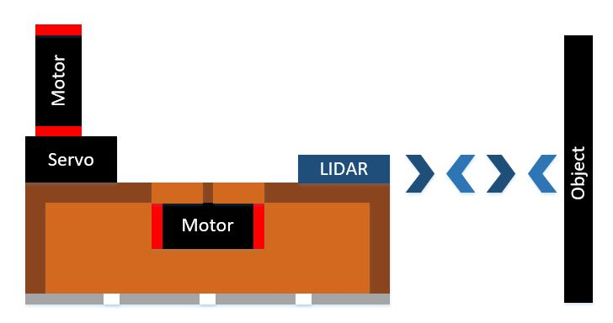
Functionality
Motor to create air cushion
Motor to propel craft forward
Servo to steer craft
LIDAR to avoid collisions

Slide 4
Parts List
Materials
Jumper Wires
Breadboard
Barrel Jack Connectors Aluminum Foil
Cardboard
Packing Tape
Tools
Scissors
Exacto
Screw Driver
Table of Electrical Parts
Part Name | Quantity
MBED LPC1768 Microcontroller | 1
Adafruit Bluetooth LE UART Friend | 1
Hitec HS-422 Servo | 1
Adafruit VL53LOX LIDAR | 1
1104-6700Kv Brushless Motor | 2
Spedix GS30A ESC | 2
9V 1A Power Supply | 2
5V 2A Power Supply | 1

Slide 5
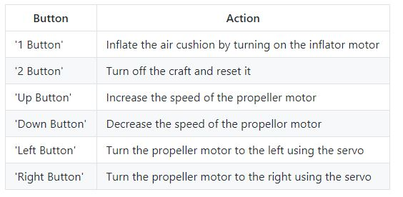
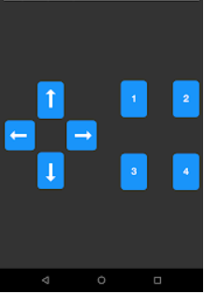
Code Overview
Setup pins, variables
Main that constantly reads LIDAR and serial connection that triggers functionalities on certain button presses
Helper functions for above functionalities
Table for Adafruit App functionalities and Adafruit App GUI

Slide 6
Autonomous Control
Use LIDAR sensor to avoid collision
Control of both brushless motors and servos
Implemented using State Space Integral control
Controlled Device | Outputs
Inflator Motor | Immediate stop
Propeller Motor | Speed control
Servo | Turn left or right to avoid object

Slide 7
End of Presentation
More info available at:
https://github.com/jdomogala/Hovercraft
Full video:
https://www.youtube.com/watch?v=8YloxDpKNwA

